Slide 1

WELCOME

Slide 2
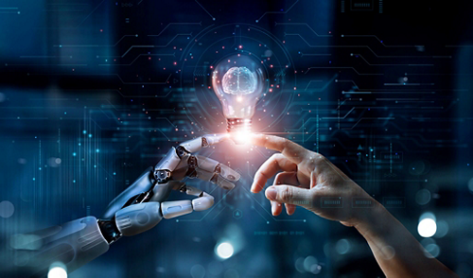
Introduction to AI and ML
Artificial Intelligence (AI) refers to the ability of machines to simulate human intelligence. It enables machines to perform tasks that typically require human cognition, such as problem-solving, decision-making, language processing, and perception. AI encompasses a wide range of technologies and approaches, one of which is Machine Learning (ML). ML is a subset of AI that allows machines to learn patterns from data and improve their performance on tasks without explicit programming.

Slide 3

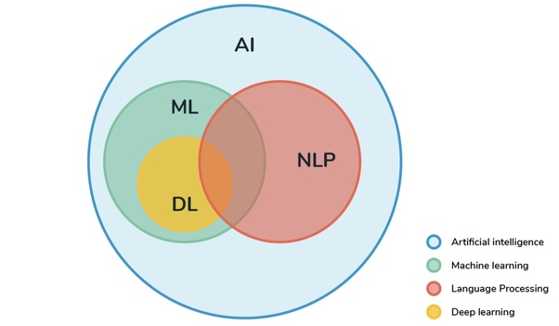

Slide 4
Subfields of ML
Machine Learning (ML) Subfields
1.Supervised Learning – Training models on labeled data (Regression, Classification)
2.Unsupervised Learning – Identifying patterns in unlabeled data (Clustering, Dimensionality Reduction)
3.Reinforcement Learning – Learning through rewards and penalties (Robotics, Game AI)
4.Deep Learning – Neural networks for complex tasks like image recognition and NLP

Slide 5
KEY APPLICATIONS OF ML
Natural Language Processing (NLP) – Understanding and generating human language
Used in: Chatbots, translation, sentiment analysis, text summarization
Computer Vision (CV) – Processing and analyzing visual data (images/videos)
Used in: Facial recognition, medical imaging, object detection
Robotics – Creating intelligent machines that interact with the physical world
Used in: Autonomous robots, industrial automation, self-driving cars
Expert Systems – AI-driven decision-making systems based on knowledge and rules
Used in: Medical diagnosis, financial analysis, legal advisory
Speech Recognition – Converting spoken language into text
Used in: Voice assistants (Siri, Alexa), transcription services, language modeling
Recommender Systems – Personalized content suggestions
Used in: Netflix, YouTube, Amazon product recommendations

Slide 6
Computer Vision (CV) Vs Natural Language Processing (NLP)
Type of Data – CV deals with images and videos, while NLP focuses on text and speech.
Core Objective – CV enables machines to see and interpret visual content, whereas NLP helps machines understand and generate human language.
Challenges – CV faces issues like with ambiguity, context understanding, and multilingual variatlighting conditions, occlusion, and object variations, whereas NLP struggles ons.
Applications – CV is used in facial recognition, self-driving cars, medical imaging, while NLP powers chatbots, translation services, sentiment analysis, and speech recognition.

Slide 7

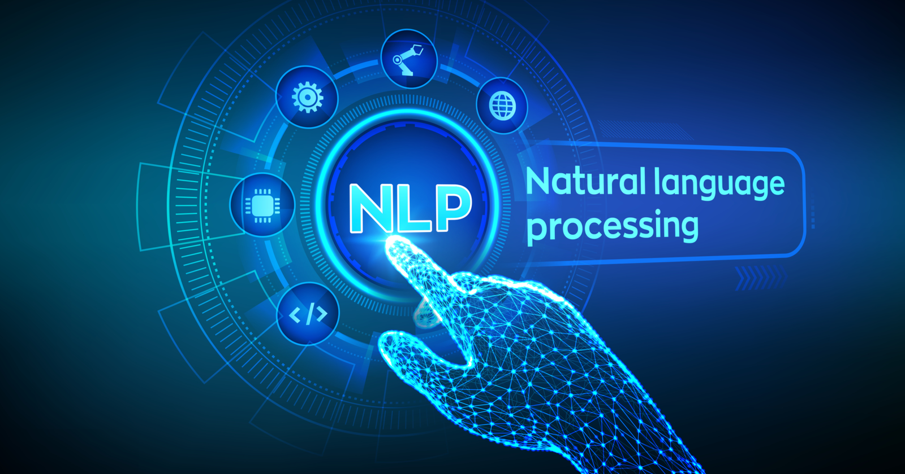

Slide 8
WHAT IS NLP?
Natural Language Processing (NLP) is a field of Artificial Intelligence (AI) that enables machines to understand, interpret, generate, and manipulate human language. It combines linguistics, machine learning, and deep learning to process text and speech data.

Slide 9
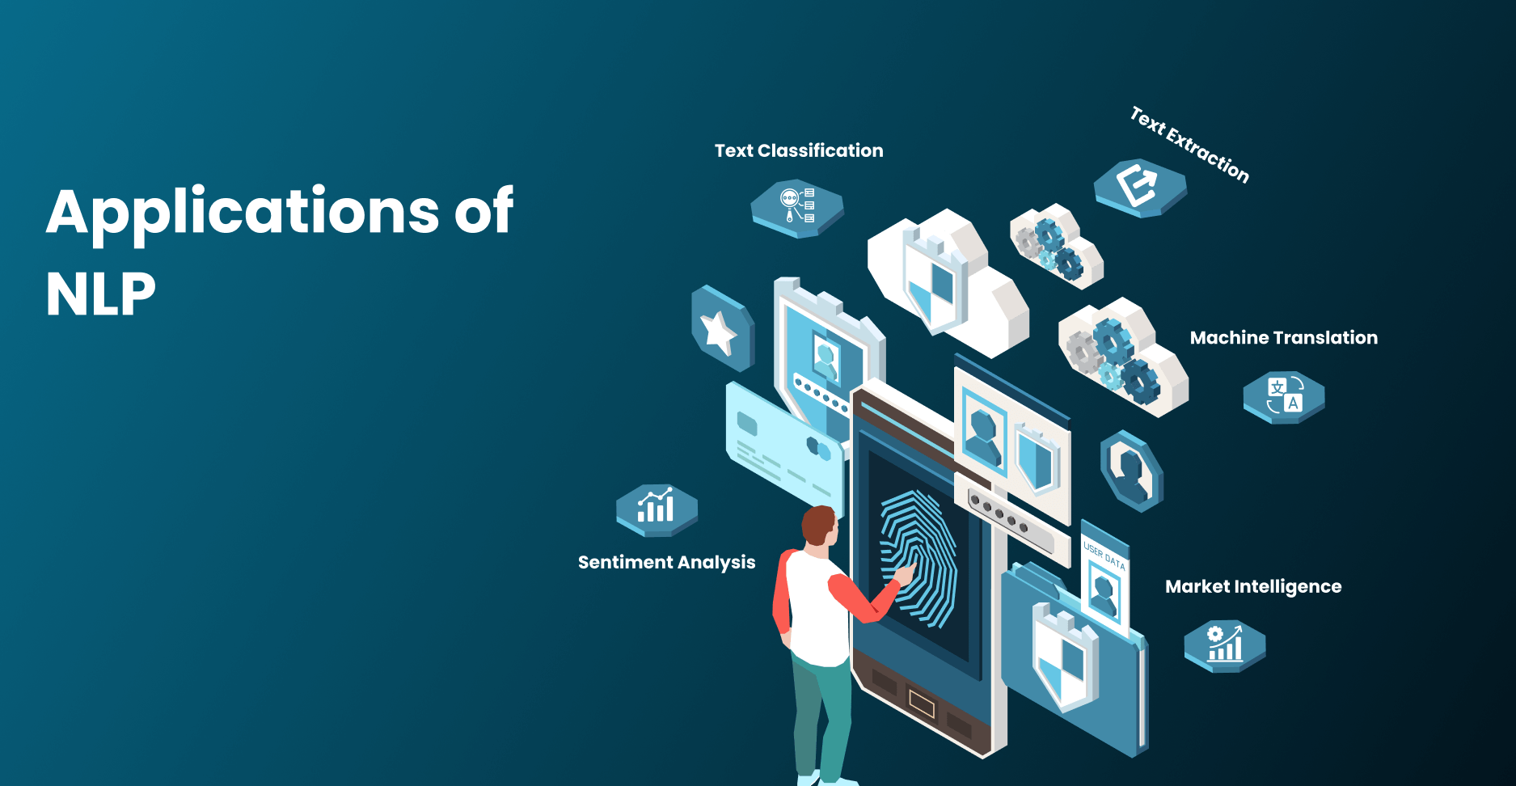

Slide 10
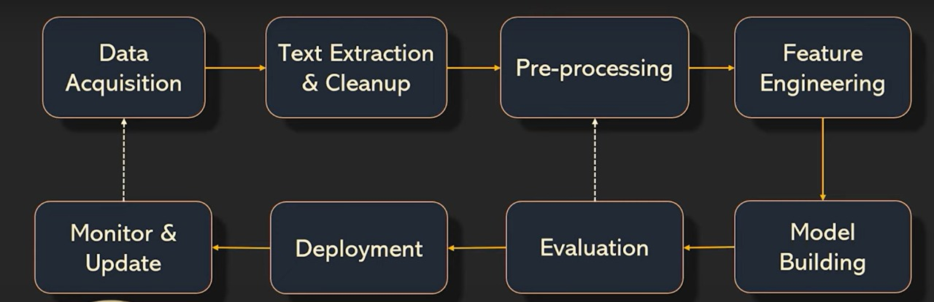

Slide 11
Why is Text Preprocessing Important?
Raw text contains noise like punctuation, stopwords , and variations in words (e.g., 'running' vs. 'ran').
Preprocessing helps clean and standardize text data.
It improves accuracy and efficiency of NLP models by reducing redundant information.

Slide 12
Tokenization
Tokenization is the process of splitting text into smaller units called tokens.
Types of Tokenization:
Word Tokenization: Splitting text into words.
Sentence Tokenization: Splitting text into sentences.
Example:
Input: 'NLP is amazing! I love learning it.'
Sentence Tokenization:
['NLP is amazing!', 'I love learning it.']
Word Tokenization:
['NLP', 'is', 'amazing', '!', 'I', 'love', 'learning', 'it', '.']

Slide 13
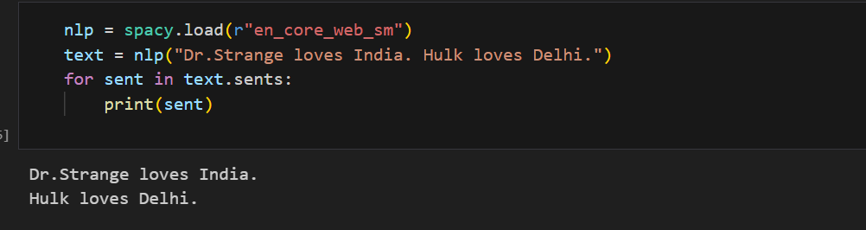
Sentence tokenization
If you use period as a delimiter you might see the output as follows:
Sentence: Dr. Strange loves India. Hulk loves Delhi.
Dr.
Strange loves India
Hulk loves Delhi.

Slide 14
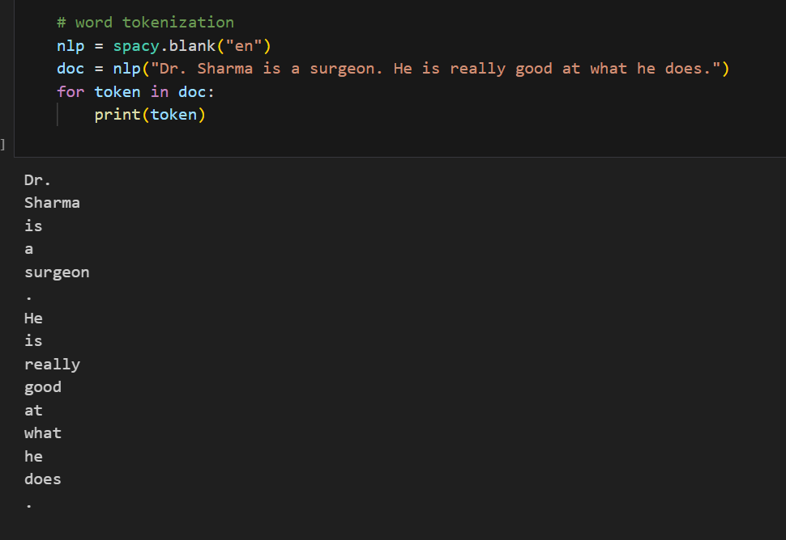
Word Tokenization

Slide 15
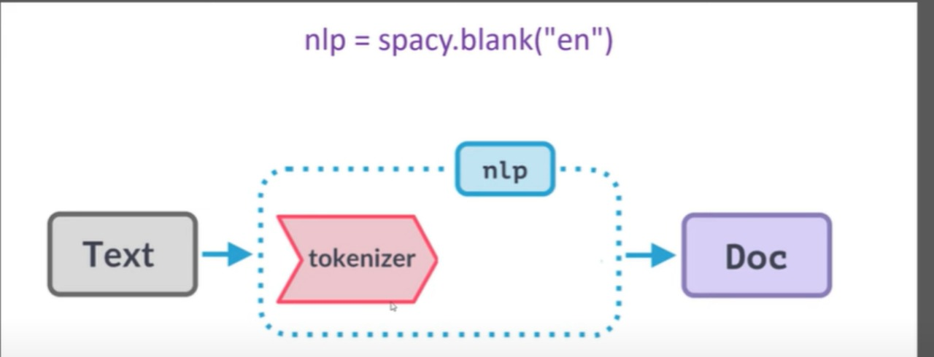
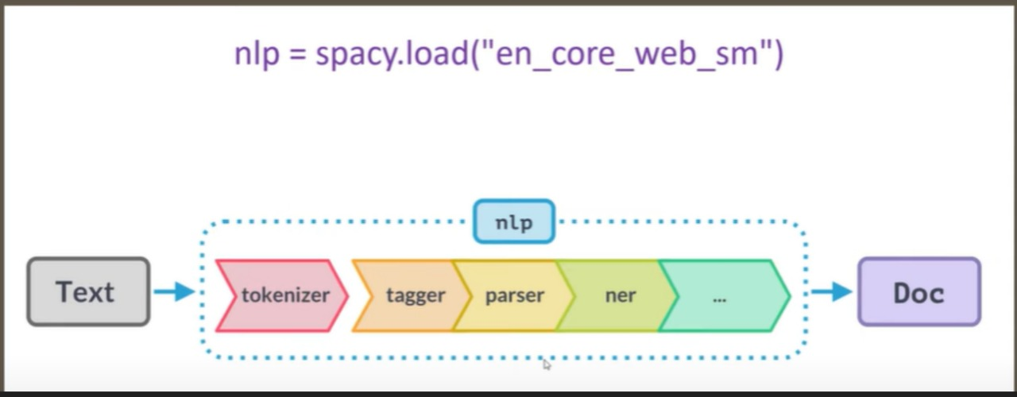

Slide 16

Stop word Removal
Stopwords are common words that do not add significant meaning. e.g., 'the', 'is', 'and', 'but', 'a’.
Since stopwords appear frequently in text, removing them helps reduce processing time and improves text analysis.
Example:
Input: 'I love to play football, but sometimes it is tiring and exhausting.'
After Stopword Removal: ['love', 'play', 'football', ',', 'sometimes', 'tiring', 'exhausting']

Slide 17
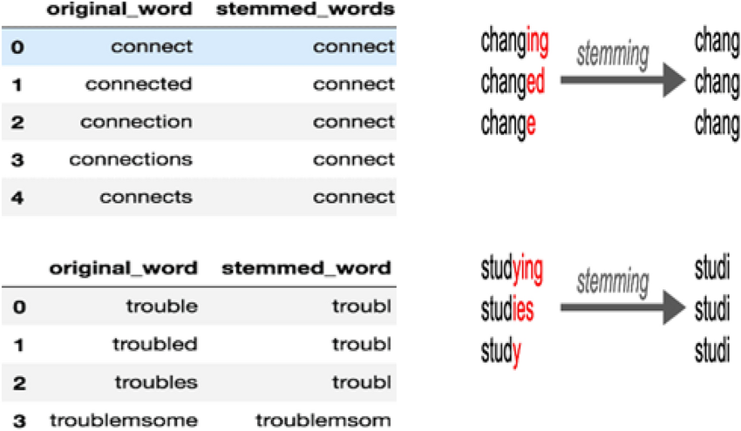
Stemming
Stemming is the process of reducing a word to its root form by removing prefixes and suffixes. It does not always produce actual words but helps in reducing dimensionality.
Example:
Input: ['running', 'runs', 'easily', 'fairly']
Output: ['run', 'run', 'easili', 'fairli']

Slide 18
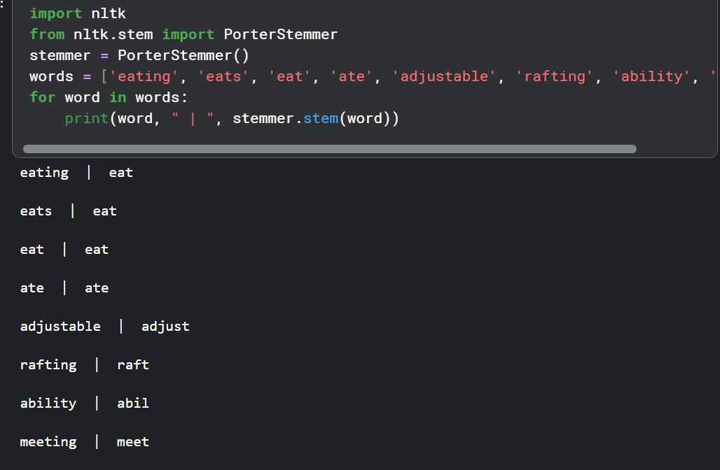

Slide 19
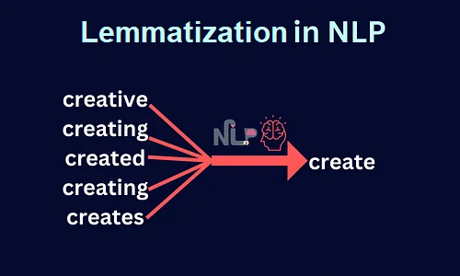
Lemmatization
Lemmatization reduces words to their base/dictionary form while considering context.
It produces valid words and requires linguistic knowledge.
Example:
Input: ['running', 'flies', 'better', 'leaves']
Output: ['run', 'fly', 'good', 'leaf']

Slide 20
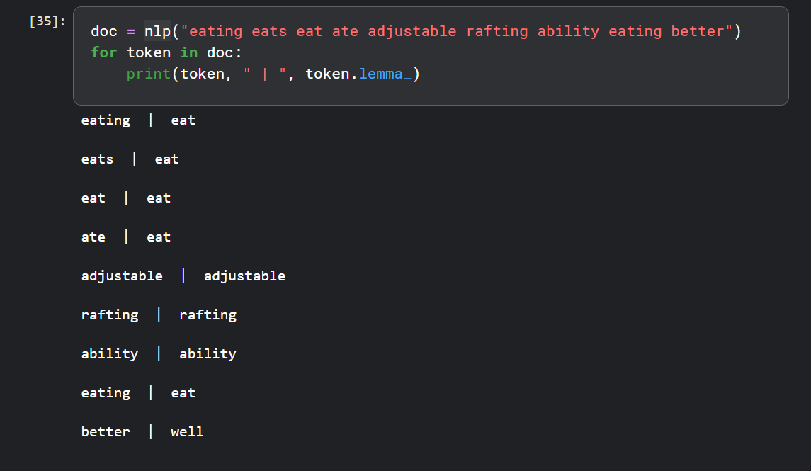

Slide 21
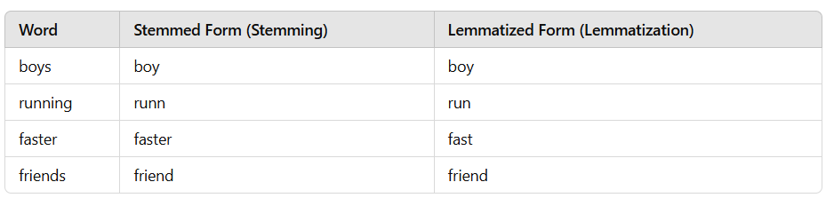
Stemming vs. Lemmatization
Stemming : Faster, rule-based, may not always return valid words.
Lemmatization : More accurate, uses linguistic knowledge, returns valid words.
Example Comparison:
Word: 'Caring'
Stemming Output: 'Car'
Lemmatization Output: 'Care'
Sentence:
"The boys are running faster than their friends."

Slide 22
Part-of-Speech (POS) Tagging
POS tagging assigns grammatical categories (noun, verb, adjective, etc.) to words.
Helps in understanding sentence structure and meaning.
Example:
1)Lakshya likes to play basketball.
2)Sentence: 'The quick brown fox jumps over the lazy dog.'
Output: [('The', DT), ('quick', JJ), ('brown', JJ), ('fox', NN), ('jumps', VBZ), ('over', IN), ('the', DT), ('lazy', JJ), ('dog', NN)]

Slide 23
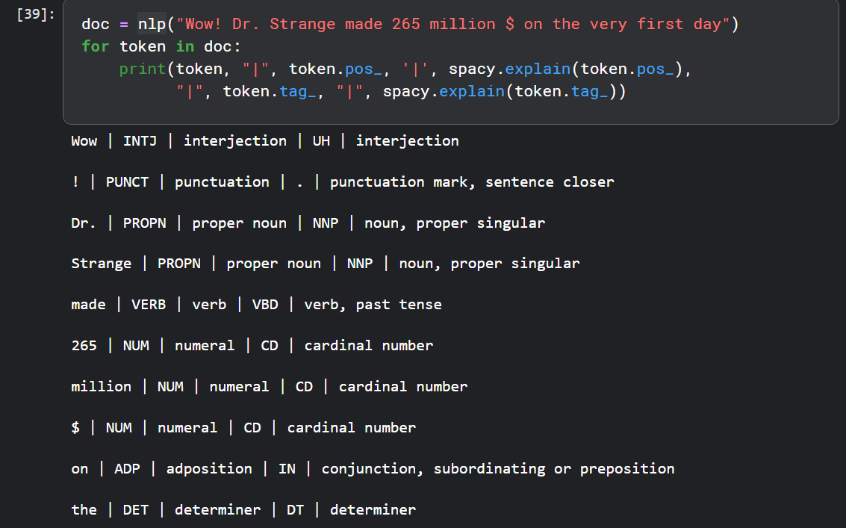

Slide 24
Regular Expressions (Regex) in NLP
Regex is used for pattern matching in text data.
Common use cases:
Extracting emails: `\S+@\S+`
Extracting phone numbers: `\d{3}-\d{3}-\d{4}`
Removing special characters: `[^a-zA-Z0-9 ]`
Example:
Input: 'Contact me at example@mail.com or call 123-456-7890.'
Extracted Email: ['example@mail.com']
Extracted Phone: ['123-456-7890']

Slide 25
Regular Expressions (Regex) in NLP
List of Regular Expression (Regex) meta-characters:
. - Matches any character except a newline
^ - Matches the start of a string
$ - Matches the end of a string
\ - Escapes special characters
* - Matches 0 or more occurrences of the preceding character
+ - Matches 1 or more occurrences of the preceding character
? - Matches 0 or 1 occurrence of the preceding character
{n} - Matches exactly `n` occurrences
{n,} - Matches `n` or more occurrences
{n , m} - Matches between `n` and `m` occurrences
[ ] - Matches any single character within the brackets
[^ ] - Matches any single character not within the brackets
| - Acts as an OR operator
() - Groups expressions together
\w - Matches any word character (letters, digits, underscore) [A-Za-z0-9_]
\W - Matches any non-word character
\d - Matches any digit [0-9]
\D - Matches any non-digit character
\s - Matches any whitespace (space, tab, newline)
\S - Matches any non-whitespace character
\b - Matches a word boundary
\B - Matches a non-word boundary

Slide 26
Deep Dive into NLP Text Representation

Slide 27
Text Representation
Text representation refers to how text data is structured and encoded so that machines can process and understand it. Human language is inherently complex, filled with nuances, ambiguities, and variations. While humans can intuitively grasp the meaning of words and sentences, computers require numerical formats to analyze and interpret language.
Why is Text Representation Important?
Machines process numbers, not raw text.
Proper text representation converts words into numerical form.
Used in sentiment analysis, spam detection, chatbots, search engines.
Types of representations : BoW , TF-IDF, and Word Embeddings.

Slide 28
Bag of Words (BoW) - Basics
The Bag-of-Words model is one of the simplest and most straightforward approaches to text representation. It involves representing a document as a collection (or “bag”) of its words, disregarding grammar and word order. In BoW , the text is treated as a set of individual words, and each word is counted for frequency in the document. The result is a vector that contains counts of words in the document.
Ignores: Grammar, word order, and meaning.
How It Works?
Tokenize the text into individual words.
Create a vocabulary (a list of all unique words across the dataset).
Count how many times each word from the vocabulary appears for each document.
Represent each document as a vector of word counts, where each vector element corresponds to a word in the vocabulary.
Advantages:
Simple and easy to implement.
Works well for text classification tasks where word frequency is an important feature.

Slide 29
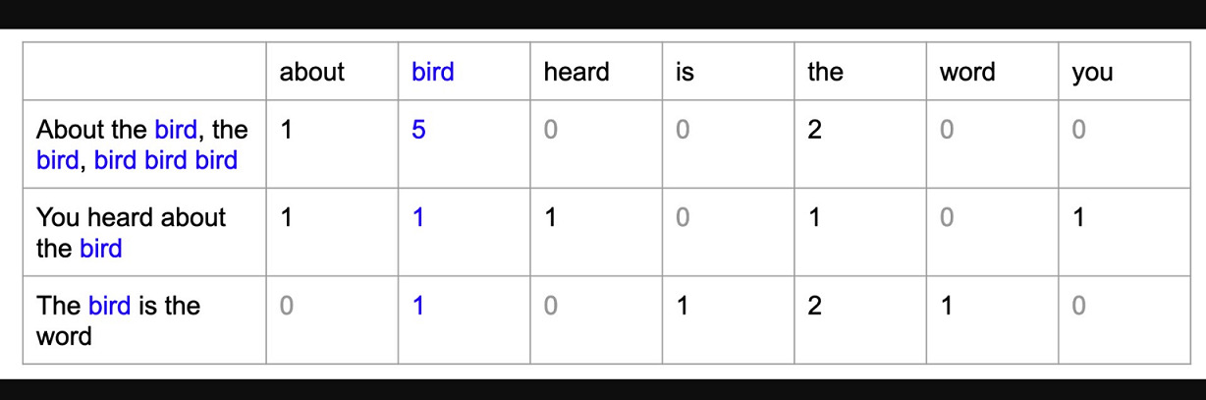
Bag of Words (BoW)

Slide 30
Bag of Words (BoW)
Disadvantages:
Ignores context: Since word order is not considered, BoW loses important information about the structure and meaning of sentences.
High dimensionality: The resulting vectors can become very large and sparse (containing many zeros) for large vocabularies.
Out-of-vocabulary words: Any word not in the predefined vocabulary is ignored, leading to information loss.

Slide 31
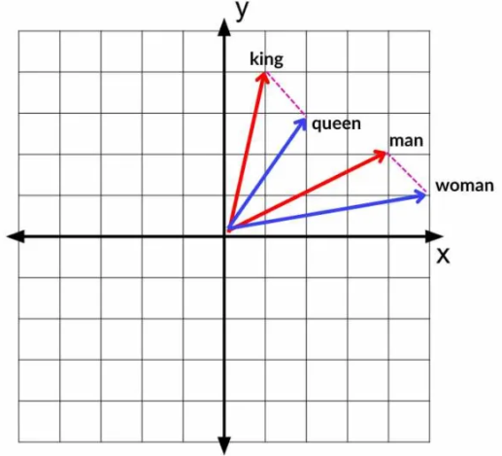
Word Embeddings: A Major Leap Forward in Text Representation
Word embeddings are dense vector representations of words where each word is mapped to a point in a continuous vector space. Unlike sparse and high-dimensional BoW or TF-IDF vectors, embeddings are low-dimensional, capturing rich semantic relationships between words. The core idea is that words with similar meanings or that appear in similar contexts will have vectors that are close together in the embedding space.
Ex:The words “king” and “queen” or “cat” and “kitten” would have vectors that are similar in the embedding space, reflecting their semantic similarity.

Slide 32
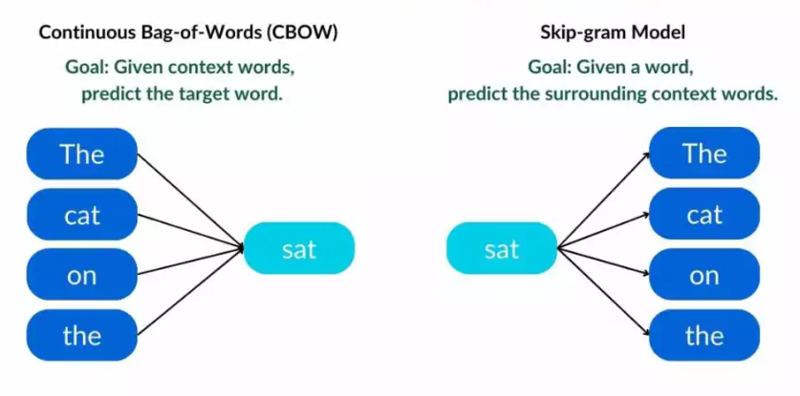
Word2Vec: Learning Word Relationships
Word2Vec creates word embeddings by analyzing large amounts of text and learning relationships between words. It does this using two main methods:
CBOW (Continuous Bag of Words): Predicts a word given surrounding words.
Skip-gram: Predicts surrounding words given a word.
Example sentence : The cat sat on the mat.

Slide 33
Word2Vec
Advantages of Word2Vec:
Captures context: Word2Vec embeddings capture semantic information by training on the context in which words appear.
Efficient: Word2Vec’s training process is computationally efficient, even for large datasets.
Word Relationships: The embeddings preserve meaningful word relationships, enabling vector arithmetic (e.g., “king” – “man” + “woman” = “queen”).

Slide 34
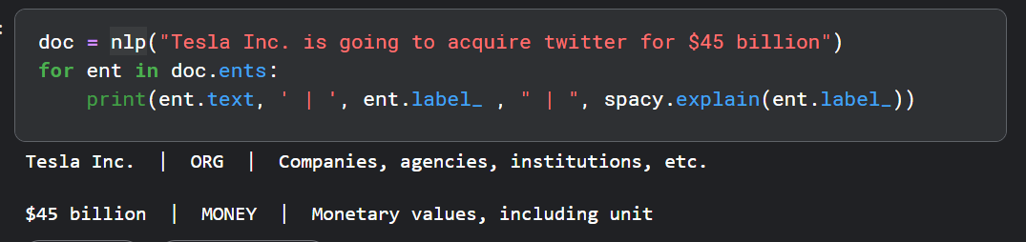
Named Entity Recognition (NER)
Named Entity Recognition (NER) is an essential subtask of Natural Language Processing (NLP) that identifies and categorizes named entities in text into predefined classes.
Ex:
“Apple Inc. was founded by Steve Jobs in Cupertino in 1976."
NER identifies:
Apple Inc. → ORG (Organization)
Steve Jobs → PERSON
Cupertino → GPE (Geopolitical Entity - Location)
1976 → DATE

Slide 35
Why is NER Important?
Helps in Information Extraction (e.g., extracting company names from news articles)
Enhances Search Engine Optimization (SEO) (e.g., improving search relevance)
Supports Question Answering Systems (e.g., answering "Who founded Apple?")
Aids in Chatbots and Virtual Assistants (e.g., recognizing entities for better responses)
Useful for Sentiment Analysis (e.g., determining sentiments about brands or people)

Slide 36
Sentiment Analysis

Slide 37

Introduction to Sentiment Analysis
Determines sentiment of text (positive, negative, neutral).
Used in social media monitoring, product reviews, finance, etc.
Approaches: Rule-based, machine learning, deep learning.
Challenges: Sarcasm, negation, context understanding.

Slide 38
Challenges in Sentiment Analysis
Handling sarcasm and irony.
Understanding context and negations.
Domain-specific sentiment variations.
Dealing with mixed sentiments in a sentence.

Slide 39
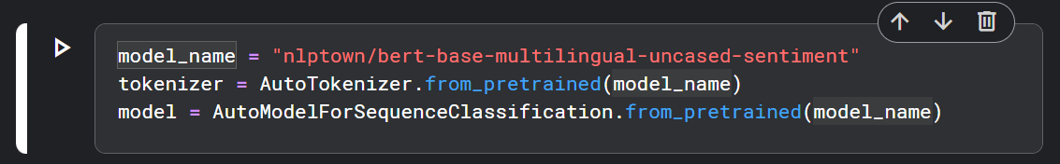
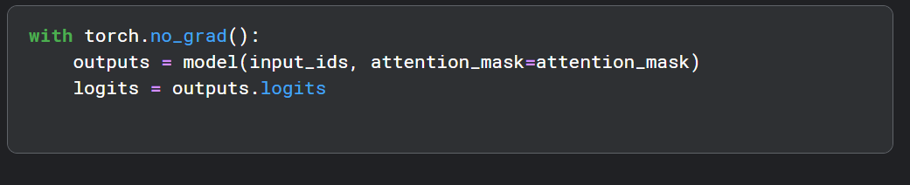
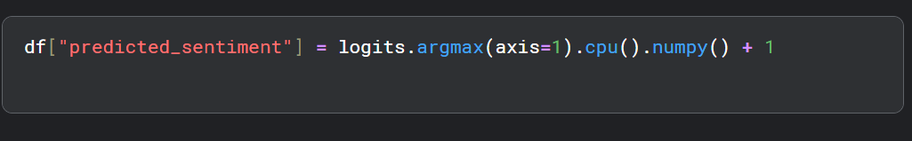

Slide 40
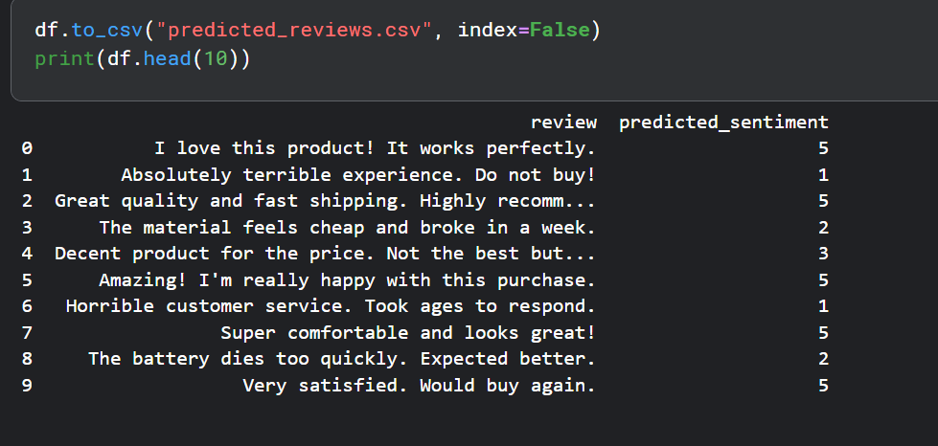

Slide 41


